Slide 1

Neonatal 36

Slide 2
OBJECTIVES
The purpose of this project is to create a database to track the medical conditions of a child for initial 36 hours from the time of birth.
To develop a one stop database consisting of symptoms, cause, treatment from the diagnosis and corresponding diseases which a child could possibly be prone to immediately after birth.
Managing and maintaining the information of the diseases that premature babies are prone to.

Slide 3
NEONATAL INTENSIVE CARE UNIT
A neonatal intensive-care unit (NICU), is an intensive-care unit specializing in the care of ill or premature newborn infants.
A NICU is typically directed by one or more neonatologists and staffed by nurses, nurse practitioners, pharmacists, physician assistants, resident physicians, and respiratory therapists, dietitians.
It has been identified that babies who are been treated in NICU fall under the following two categories:
Pre term baby
Full term baby

Slide 4
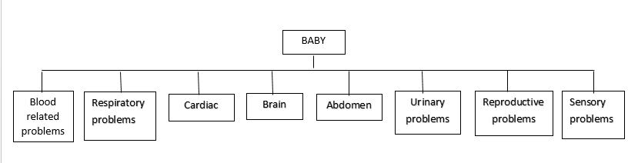
CATEGORIES OF DISEASES A BABY IS PRONE TO

Slide 5
PEDIATRIC VITAL SIGN NORMAL RANGES
AGE GROUP | RESPIRATORY RATE | HEART RATE | SYSTOLIC BLOOD PRESSURE | WEIGHT IN KILOS | WEIGHT IN POUNDS
NEWBORN | 30-50 | 120-160 | 50-70 | 2-3 | 4.5-7
VITAL SIGN | INFANT
HEART RATE | 0 TO 12 MONTHS
 | 100 TO 160 BEATS PER MINUTE (BPM)
RESPIRATORY | 0 TO 6 MONTHS
 | 30 TO 60 BREATHES PER MINUTE (BPM)
 | 6 TO 12 MONTHS
 | 24 TO 30 BREATHES PER MINUTE (BPM)
BLOOD PRESSURE | 0 TO 6 MONTHS
 | 65 TO 90/45 TO 65 MILLIMETERS OF MERCURY
 | 6 TO 12 MONTHS
 | 80 TO 100/55 TO 65 MILLIMETER OF MERCURY
TEMPERATURE | ALL AGES
 | 98.6 F (NORMAL RANGE 97.4 F- 99.6 F)

Slide 6
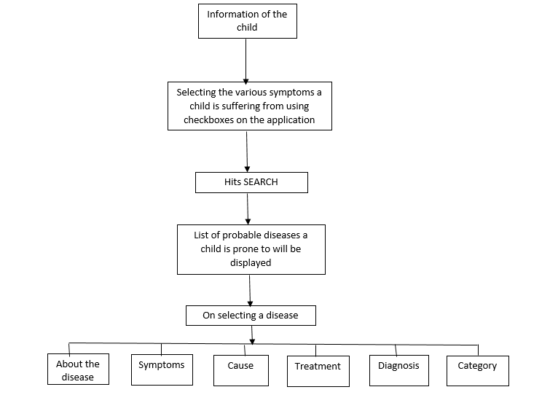
FLOW DIAGRAM

Slide 7
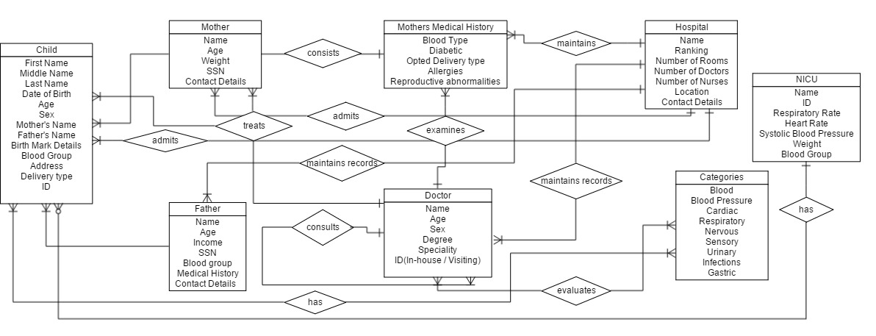
ER DIAGRAM

Slide 8
THANK YOU!

